Slide 1
Parent Engagement on Relationships, Sex and Health Education

Slide 2
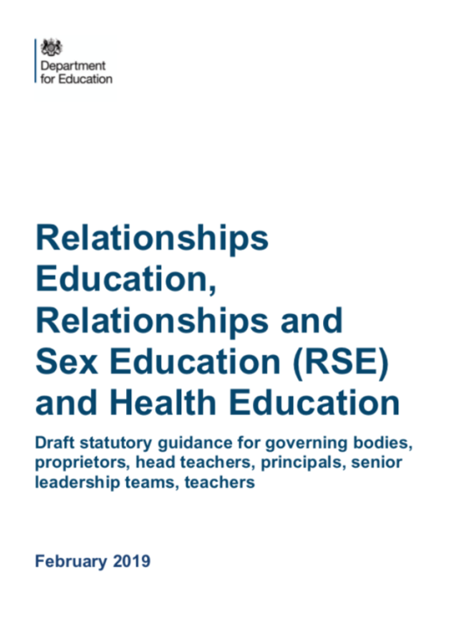
Why is the curriculum changing?
We want all children to grow up healthy, happy, safe and able to manage the challenges and opportunities of modern Britain. That is why, from April 2021, all primary age children will be taught Relationships and Health Education as a statutory part of the school curriculum.
The learning units are designed to equip your child with the knowledge and skills to make informed decisions about their wellbeing, health and relationships, as well as preparing them for a successful adult life. Young people live in a rapidly changing world so the new statutory curriculum content is relevant to the 21st century.

Slide 3
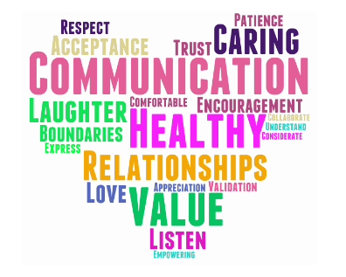
What does the new statutory guidance cover?
Relationships Education
The focus of Relationships Education is on teaching the fundamental building blocks and characteristics, with particular reference to friendships, family relationships and relationships with other children and with adults. Department for Education guidance requires us to teach objectives under the following topics:
Families and people who care for me
Caring Friendships
Respectful Relationships
Online Relationships
Being Safe
You cannot withdraw your child from Relationships Education because it is now a legal requirement: it is important that all children receive this content.

Slide 4
Health Education
The focus of Health Education is on teaching the characteristics of good physical health and mental wellbeing. Elements of our Health Education are timetabled to complement and support the teaching of RSE.
Department for Education (DfE) guidance requires us to teach objectives under the following topics:
Mental Wellbeing
Internet Safety and Harms
Physical Health and Fitness
Healthy Eating
Drug, Alcohol and Tobacco
Health and Prevention
Basic First Aid
The Changing Adolescent Body (Puberty)

Slide 5
Science Curriculum
As part of the Science curriculum, we teach the following statutory objectives that build understanding about growth and reproduction:
Key Stage 1 (age 5-7 years)
Identify, name, draw and label the basic parts of the human body and say which part of the body is associated with each sense
Notice that animals, including humans, have offspring which grow into adults
Describe the importance for humans of exercise, eating the right amounts of different types of food and hygiene

Slide 6
Science Curriculum
Key Stage 2 (age 7-11 years)
Describe the life process of reproduction in some plants and animals.
Describe the changes as humans develop to old age.
Recognise that living things produce offspring of the same kind, but normally offspring vary and are not identical to their parents.
Recognise the impact of diet, exercise, drugs and lifestyle on the way their bodies function.

Slide 7
The aims of RSHE at Holy Trinity
Through RSHE, we deliver key learning that supports our school’s agreed Christian ethos and values. Key values supported by RSHE include:
Respect for self and others
Building positive caring relationships
Respecting diversity
Feeling safe and valued
Self-awareness and self-esteem
Exploration of rights, duties and responsibilities

Slide 8
Next steps:
Please look at the materials on the school website and complete our survey. We are particularly interested in your views and any areas you might like further support with at home.
We are aware that there will be differences of opinion, but we will take your views into consideration when we finalise our school policy and curriculum plan.
We will share the curriculum plan with you in the summer term.

Slide 9
Can I withdraw my child from RSHE?
From April 2021, parents and carers have the right to withdraw their child from sex education outside of the Science curriculum. The only sex education content outside the science curriculum is in Year 6.
From April 2021, parents do not have the right to withdraw their child from lessons on Relationships or Health Education or the Science curriculum.
If a parent or carer wishes to withdraw their child from Sex Education in Year 6, we ask that they put it in writing and discuss it with Mrs MacGregor in the first instance.
Parents and carers are responsible for educating their child/ren about the areas of Sex Education which they have withdrawn them from. The school may ask parents/carers how they plan to do this.

