Slide 1
Here We Are
On Thursday and Friday this week, we are going to spend three lessons looking at our book from the beginning of term, Here We Are by Oliver Jeffers.
Some of the learning will be PSHE-based and some will be English learning objectives.

Slide 2
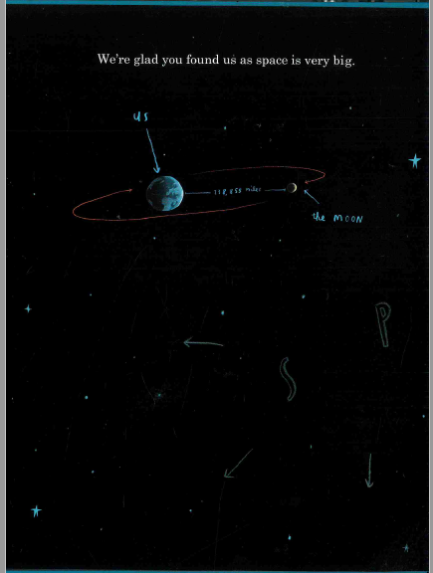

Slide 3
Special People
We all have some very special people in our lives and they are even more important when things are challenging.
We are going to spend some time thinking about our special relationships: maybe you have a very close friendship, a really fun or supportive aunt or uncle or an amazing gran or grandad?
We know some of you have pets that are really special to you, but, for this task, we would like you to stick to humans.

Slide 4
What makes someone ‘special’?
Take some time to think carefully about these questions:
What makes these individuals special to you?
Why do you like spending time with them?
What do you enjoy doing with this person?
How do you think they feel about you?
How do you know? How do you let this person know that they are special to you?
What are our responsibilities in these relationships? (eg. How do we take care of them; have quality time with them etc)

Slide 5
Now for some art!
Task 1: Now, have a go at drawing your favourite memory of a time you spent with your special person. Use A4 paper or anything suitable which you have available.
You could listen to some calming music as you draw, to help you concentrate.
Aren’t we lucky that we happen to be on earth at the same moment and time as these amazing human beings!

Slide 6
Letter to a Loved One
Task 2: Today we are going to write to our very special person, spreading a little love and happiness. We are going to write to them how we feel about them and how grateful we are that they have a place in our lives.
You can use the questions on the earlier slides to help you. You could tell your special person about your favourite memory which you have of them, which you drew in the last task.
Should the layout of your letter be formal or informal, do you think? What are the rules for setting out that style?
You might want to write a draft of your letter and then present your final version in your best handwriting. Or you could type it and print it if you wished.
Remember to check your punctuation, grammar and spelling choices carefully.

Slide 7
The finishing touches
When you come back to school (not long now!) you can choose some A3 card, fold it in half, stick your drawing on the front of the card and stick your final version of the letter inside the card.
Then we could send this off to your special loved one.

Slide 8
A Recipe for Success
Our special relationships are a bit like having an amazing recipe – they take lots of ingredients that come together to make something spectacular.
What are the important ‘ingredients’ in any relationship , whether it is with a friend, someone in your family, a carer, a teacher? You might want to think about ideas like trust, communication, being free to be yourself, being understanding.
Are these relationship skills similar to our school values? Are they similar to any of the Christian Values which we learn about in Worship?

Slide 9
Have a think about all the relationships you have which work well, whether that is with other children or adults. Why is this? Do both people in the relationship need to treat each other in the same way?
What happens if things go wrong and someone doesn’t behave in the ‘right’ way?
Can you think how that might happen in relationships which you are part of? Have there been playground disagreements or problems in a sports match?
Both sides in a relationship have to work together to make a relationship work over time.

Slide 10
In any relationship, the people involved have rights and responsibilities.
For example, if we expect our friends to be trustworthy, we shouldn’t tell anyone private information they have told us.
If we don’t do our full share of ‘give’ and ‘take’, the relationship may be damaged or break down. Then people may need to compromise or apologise for the sake of the reltionship.

Slide 11
Create your Relationship Recipe!
Task 3: We are going to write some instructions for maintaining strong, positive relationships.
Make a list of all the important things you feel are essential to make successful relationships.
eg. 4 bags of kindness; 500ml of understanding; 2 tablespoons of quiet; a bottle of sharing etc
-

Slide 12
What do instructions need?
Now, think about what you know about instruction writing (Remember that we use imperative/bossy verbs); we order our instructions; we use simple sentences ; pictures etc)
eg. Mix the packet of smiles with the bottle of honesty to create a strong, flexible mixture…
You might want to think about an instruction for when a relationship goes wrong…
eg. If the mixture becomes bitter and stiff, add a blend of kindness and understanding…
Write an illustrated Recipe for Successful Relationships.

Slide 13
Time to reflect…
Take some time to play some calming meditational music whilst you think through the variety of relationships which you are part of - and the valuable role you play in them.
Remember how important you are to those around you – you are amazing!

