Slide 1
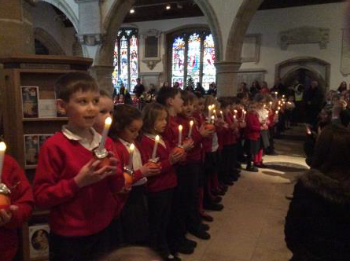

Welcome to our Junior
Christingle Service
Friday 20th December 2019

Slide 2
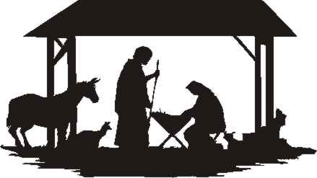
WELCOME: Introduction to the Christingle
Away in a Manger
4 Bars
Away in a manger, no crib for a bed,
The little Lord Jesus laid down his sweet head.
The stars in the bright sky looked down where he lay,
The little Lord Jesus asleep on the hay.
2 bars
The cattle are lowing, the baby awakes,
But little Lord Jesus no crying he makes,
I love thee, Lord Jesus! Look down from the sky,
And stay by my side until morning is nigh.
2 Bars
Be near me, Lord Jesus, I ask thee to stay
Close by me for ever, and love me I pray.
Bless all the dear children in thy tender care,
And fit us for heaven, to live with thee there

Slide 3
Year 3 and 4 Christmas Song
The Christingle Song
It’s rounded like an orange
This Earth on which we stand
And we praise the God who holds it
In the hollow of his hand
- And father we must thank you
For all that you have done
And for all that you have given us
Through the coming of your Son
A candle burning brightly
Can cheer the darkest night
And these candles tell how Jesus
Came to bring a dark world light
- And father we must thank you
For all that you have done
And for all that you have given us
Through the coming of your Son

Slide 4
The ribbon round the orange
Reminds us of the cost
How the shepherd strong and gentle
Gave his life to save the lost
- And father we must thank you
For all that you have done
And for all that you have given us
Through the coming of your Son
Four seasons with their harvest
Supply the food we need
And the spirit gives a harvest
That can make us rich indeed
- And father we must thank you
For all that you have done
And for all that you have given us
Through the coming of your Son

Slide 5
We come with our Christingles
To tell of Jesus’ birth
And we praise the God who blessed us
By His coming to this Earth
- And father we must thank you
For all that you have done
And for all that you have given us
Through the coming of your Son

Slide 6


Midnight
4 Bars
Midnight – there’s the strangest feeling in the air tonight,
There’s something going on but I can’t make it out,
I wonder what it’s all about?
2 Bars
Starlight – breaking through the darkness in the dead of night,
Illuminates the path that takes you out of sight,
And all the way to Bethlehem.
2 Bars
Tonight’s events were planned in Heaven,
The greatest story ever penned.
Heaven and Earth have come together,
And life has come to Bethlehem.

Slide 7
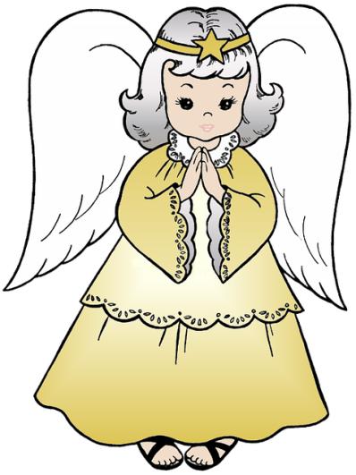
4 Bars
Angels taking care of things that only they can do,
Are waiting in the wings to bring the joyful news,
It’s going to turn the world around.
2 Bars
Strangers – having made arrangements for a night or two,
Have found accommodation in the crowded rooms.
The house is packed in Bethlehem.
2 Bars
Tonight’s events were planned in Heaven,
The greatest story ever penned.
Heaven and earth have come together,
And life has come to Bethlehem.

Slide 8
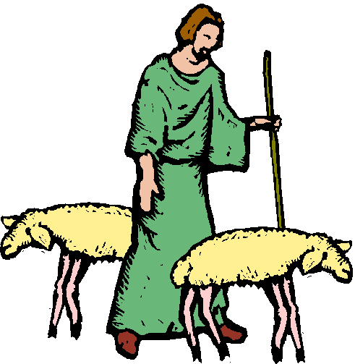
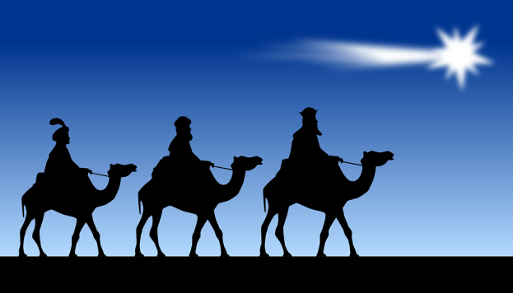
4 Bars
Shepherds – minding their own business looking after things,
Are startled by an unexpected happening,
As angel choirs appear to them.
2 Bars
Wise men – taking charts and telescopes and compasses,
Investigate the star that takes them traveling,
Until they come to Bethlehem.
2 Bars
Tonight’s events were planned in Heaven,
The greatest story ever penned.
Heaven and earth have come together,
And life has come to Bethlehem.
2 Bars
Tonight’s events were planned in Heaven,
The greatest story ever penned.
Heaven and earth have come together,
And life has come to Bethlehem.
2 Bars
And life has come to Bethlehem.
Yeah!

Slide 9
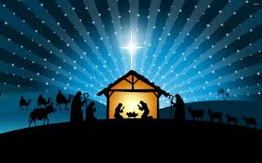
Year 5 Readings

Slide 10
Holy Trinity Choir accompanied by Father Michael on the Church Organ
Silent Night
O Come all Ye Faithful

Slide 11
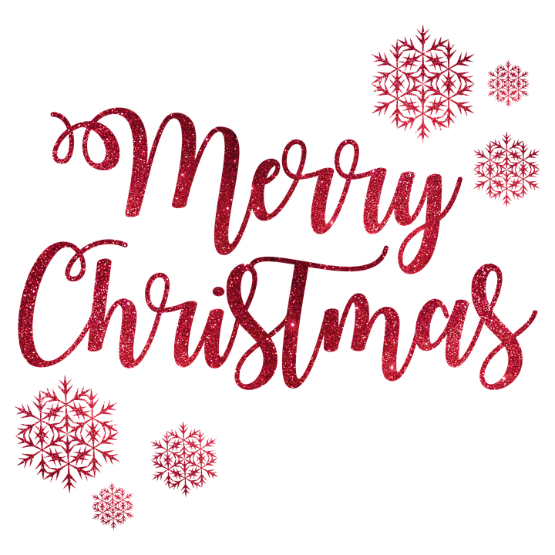
Years 6 Christmas Poems

Slide 12
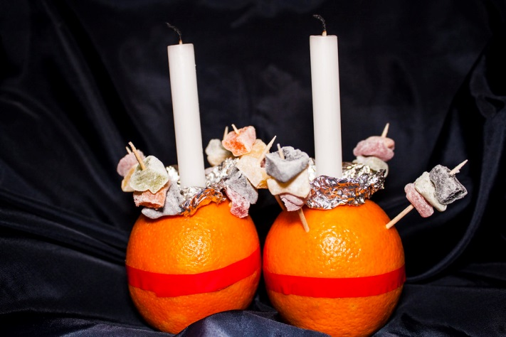
Christingle Ceremony
Please can all parents/carers remain seated at this time for the health and safety of all the children.
Please join us in singing Turn Down the Lights whilst the children collect their Christingle candles.
TURN DOWN THE LIGHTS
10 Bars
Turn down the lights and watch the fire glowing,
Colours burn bright and warm.
Now is the time for waiting and knowing,
Christmas will come with the dawn.
4 Bars
Dark is the night and gentle the snowing,
Silently white it falls.
Calm is the sight, and soft the wind blowing,
Quietly come Christmas morn.

Slide 13
2 Bars
Night before Christmas – the world is at home,
This day is over and done.
Treasure the moment when everything’s still,
Soon Christmas morning will come.
8 Bars
Under the tree the presents lie gleaming,
Ribboned and wrapped and signed.
No-one can see but everyone’s dreaming,
Thoughts of the secrets inside.
2 Bars
Night before Christmas – the world is at home,
This day is over and done.
Treasure the moment when everything’s still,
Soon Christmas morning will come.

Slide 14
8 Bars
All through the house a slumber is falling,
Settle you down to sleep.
No need to frown, it soon will be morning,
All your surprises will keep.
2 Bars
Night before Christmas – the world is at home,
This day is over and done.
Treasure the moment when everything’s still,
Soon Christmas morning will come.
2 Bars
Night before Christmas – the world is at home,
This day is over and done.
Treasure the moment when everything’s still,
Soon Christmas morning will come.

Slide 15
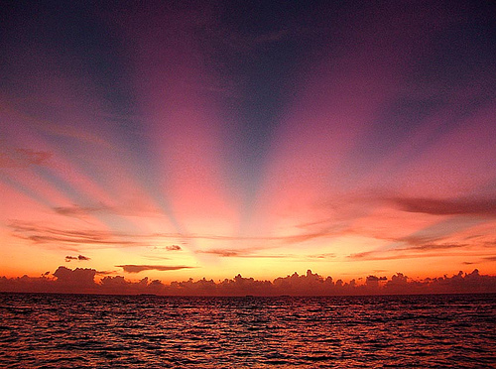
Blessing

Slide 16
Once in Royal David’s City
4 Bars (Slow)
Once in Royal David's City,
Stood a lowly cattle shed,
Where a mother laid her Baby,
In a manger for His bed.
Mary was that mother mild,
Jesus Christ her little child.
(Straight in)
He came down to earth from heaven,
Who is God and Lord of all,
And His shelter was a stable,
And His cradle was a stall:
With the poor and mean and lowly,
Lived on earth our Saviour holy.

Slide 17
(Straight in)
And through all His wondrous childhood
He would honour and obey,
Love and watch the lowly mother,
In whose gentle arms He lay.
Christian children all should be,
Kind, obedient, good as He.
(Straight in)
Once in Royal David's City,
Stood a lowly cattle shed,
Where a mother laid her Baby,
In a manger for His bed.
Mary was that mother mild,
Jesus Christ her little child.

Slide 18
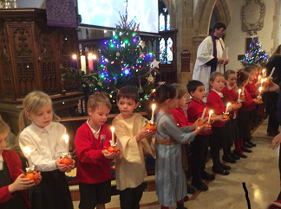
Thank you for joining us for this Christingle Service and for all your donations to the Children’s Society. We would like to wish you and your families a happy and peaceful Christmas.
And the angel answered her, “The Holy Spirit will come upon you, and the power of the Most High will overshadow you; therefore the child to be born will be called holy-the Son of God.”
Luke 1:35
At the end of the service please can parents/carers remain seated while the children leave the Church with staff and walkers to return to school. Thank you

